Slide 1
Project Presentation of Co-Op Project at Industry (Module-2)(22CS421)
On
MOODSYNC
Diya Goyal (2210994878)
Sakshi Gupta (2210992228)
Supervised By
Ms. Simarjit Kaur
Department of Computer Science and Engineering,
Chitkara University, Punjab

Slide 2


Introduction
In today’s fast-paced world, emotional well-being is often overlooked, leading to increased stress and anxiety. Studies show that 57% of people use music to manage stress. Yet, current recommendation systems rely on manual selection or predefined algorithms that don’t adapt to real-time emotions. MoodSync, which is an AI-powered software bridges this gap by using facial recognition to analyze emotions and play music, enhancing emotional well-being. With applications in mental health, stress management, and emotional awareness, this innovation transforms music into personalized therapy.
2

Slide 3

Technology Stack
Programming Language:
-Python – The core language powering our project.
-JavaScript (Node.js) – Powers the backend server and manages communication.
Machine Learning & Deep Learning:
- TensorFlow & Keras – This is for building and training deep learning models.
- Scikit-Learn – For classical machine learning algorithms and preprocessing.
Data Handling & Processing:
-Pandas – For data manipulation and analysis.
- NumPy – For numerical computing and efficient array operations.
Computer Vision:
- OpenCV (opencv-contrib-python) – For image processing and computer vision tasks.
Backend & Server
-Node.js – Server-side runtime environment to handle frontend requests and route them appropriately.
-Express.js – Web framework for Node.js used to define routes and middleware.
- child_process (Node.js module) – Used to run Python scripts from the Node.js backend.
File Handling
-Multer – Middleware for handling multipart/form-data, especially for uploading frontend images.
Multimedia Output
-Pygame – For audio playback during testing and model validation.
Development & Workflow:
- Jupyter Notebook – For interactive coding, visualization, and experimentation.
- tqdm – For progress bar visualization to track long-running processes.
- GitHub – For version control, collaboration, and communication.

Slide 4

Proposed Methodology
LOAD THE PRE-TRAINED AI MODEL FOR EMOTION DETECTION.
ACCESS THE WEBCAM FOR REAL-TIME VIDEO CAPTURE.
IDENTIFY FACES IN THE VIDEO USING OPENCV’S HAAR CASCADE.
ENHANCE IMAGE FOR BETTER AI PROCESSING.
CONTINUOUSLY PROCESS FRAMES FOR LIVE DETECTION
SHOW DETECTED EMOTION ON THE VIDEO FEED.
ANALYZE FACIAL EXPRESSIONS TO DETECT EMOTIONS.

Slide 5
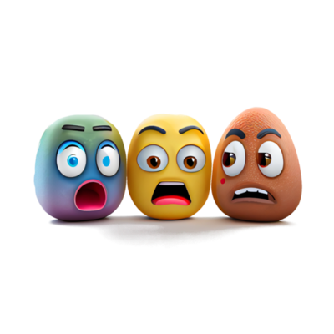
CNN Model Training Workflow
CREATE DATAFRAME WITH EXTRACTED IMAGE PATHS AND LABELS.
LOAD LIBRARIES & DATASET (KERAS, PANDAS AND NUMPY)
LOAD IMAGES, CONVERT TO GRAYSCALE (48X48), NORMALIZE AND RESHAPE FOR MODEL INPUT.
SAVE TRAINED MODEL
DEFINE & COMPILE CNN MODEL.
TRAIN THE MODEL USING MODEL.FIT(...) ON THE PROCESSED DATASET.

Slide 6
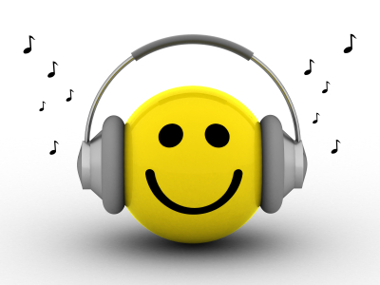
Emotion Detection and Music Playback Workflow
FRONTEND (HTML + JAVASCRIPT)
THE USER SELECTS A LANGUAGE, AND A PHOTO IS CAPTURED VIA WEBCAM.
IMAGE AND LANGUAGE ARE SENT TO HTTP://LOCALHOST:3000/DETECT VIA POST.
BACKEND (NODE.JS + EXPRESS)
RECEIVES IMAGE AND LANGUAGE WITH MULTER, STORES IMAGE IN /UPLOADS.
RUNS EMOTION.PY USING CHILD_PROCESS.EXEC() WITH IMAGE PATH.
EMOTION DETECTION MODEL (PYTHON + KERAS + OPENCV)
PYTHON SCRIPT LOADS CNN MODEL AND DETECTS EMOTION FROM THE IMAGE.
RETURNS THE EMOTION LABEL TO THE NODE.JS SERVER.
FRONTEND (AGAIN)
FRONTEND SHOWS EMOTION AND OPENS YOUTUBE LINK IN SAME TAB.
YOUTUBE SONG RECOMMENDATION
NODE.JS CREATES A YOUTUBE SEARCH QUERY USING EMOTION + LANGUAGE.
SENDS THE SEARCH URL AS JSON TO THE FRONTEND.

Slide 7
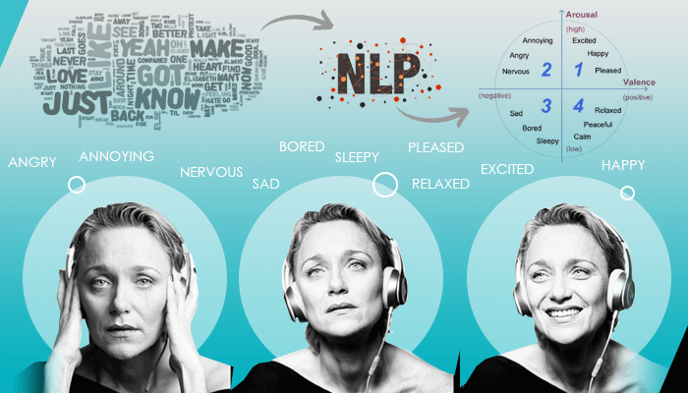
Proposed Formulation
Mood Sync performance depends on accurate emotion detection using CNN.
Facial recognition accuracy is influenced by training data quality and model robustness.
Good image quality, proper lighting, and facial alignment improve prediction results.
User engagement increases through real-time music recommendations and user-friendly interface.
Multilingual support enhances accessibility for diverse users.
Effectiveness is measured through user satisfaction, listening duration, repeat usage, and low skip rate.
Emotion detection is the core component, as wrong predictions can reduce recommendation quality.
Optimizing detection accuracy improves reliability, user experience, and acceptance of the system.

Slide 8
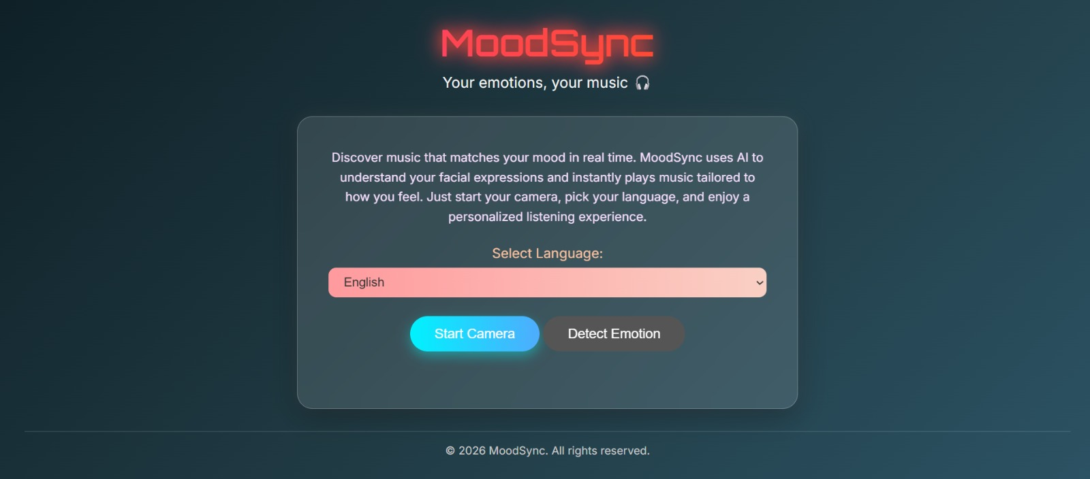
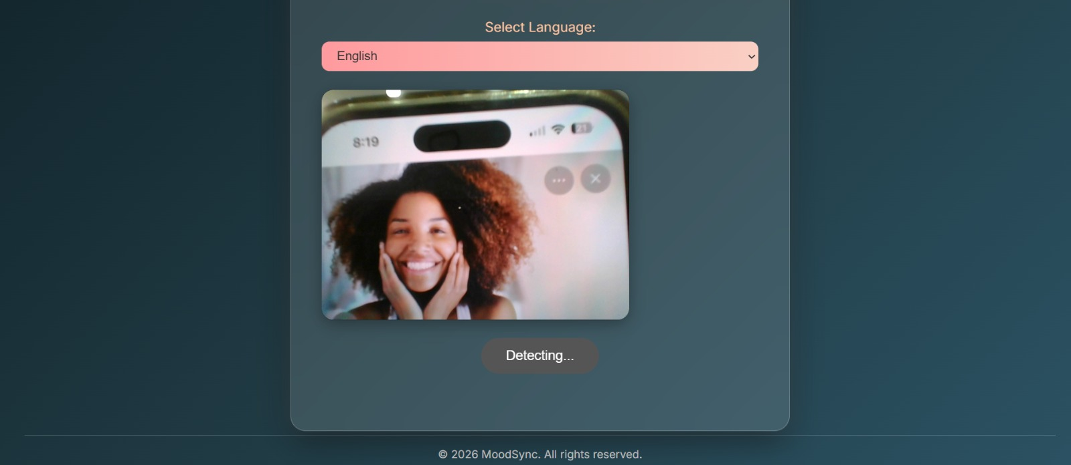
Project Evolution Output

Slide 9
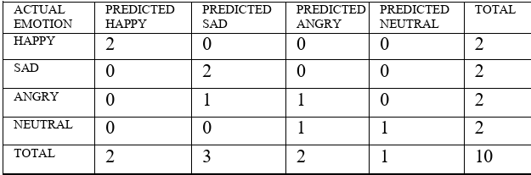
Results
The system was able to identify the following emotions – happiness, sadness, anger, calmness, surprise and neutrality.
The system can accurately map emotions to music. Eg. the detection of happy emotion led to the playback of upbeat music.
The system takes only 45 seconds between detection and playback of music, showcasing effective time performance.
Further testing results showed that out of 10 samples, the system shows accurate detection in eight of the ten samples.
Following are the test results.

Slide 10
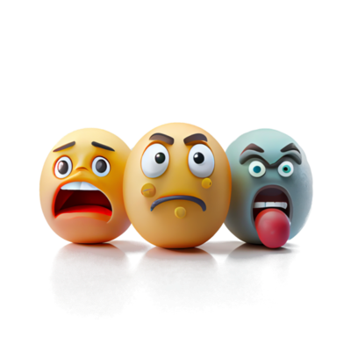
Conclusion
With a powerful CNN at its core, EmoVerse model transforms raw facial expressions into real-time emotion detection. This breakthrough bridges AI and human emotions, unlocking endless possibilities—from personalized music therapy to mental wellness solutions. The future of emotion-aware technology starts here!

Slide 11
References
Dataset Link: https://www.kaggle.com/datasets/ananthu017/emotion-detection-fer
Jaiswal, A., Raju, A.K. and Deb, S., 2020, June. Facial emotion detection using deep learning. In 2020 international conference for emerging technology (INCET) (pp. 1-5). IEEE.
Chutia, T. and Baruah, N., 2024. A review on emotion detection by using deep learning techniques. Artificial Intelligence Review, 57(8), p.203.
Pereira, R., Mendes, C., Ribeiro, J., Ribeiro, R., Miragaia, R., Rodrigues, N., Costa, N. and Pereira, A., 2024. Systematic review of emotion detection with computer vision and deep learning. Sensors, 24(11), p.3484.
Halkiopoulos, C., Gkintoni, E., Aroutzidis, A. and Antonopoulou, H., 2025. Advances in neuroimaging and deep learning for emotion detection: A systematic review of cognitive neuroscience and algorithmic innovations. Diagnostics, 15(4), p.456.

Slide 12
Thank You
12

